Slide 1
Global climatic change
-Cloud destination

Slide 2
Team members
SHOBIKA -2YR - CSE
KARTHICK SHANMUGAM -2YR -CSE
AHAMED ISMAIL -2YR -CSE
VIJAYA LAKSHMI -2YR -CSE

Slide 3
TOPICS COVERED
INTRODUCTION
SCOPE OF THE PROJECT
DATA COLLECTION
DATA PREPROCESSING
MODEL AND PARAMETERS SELECTION
ACCURACY

Slide 4
INTRODUCTION
Climate change is a major problem in the modern world and there are still some people around the world who do not believe in climate change or global warming and presenting definite proof can help spread more awareness around.
The main motivation for this project is to automate the climate change data for the machine to understand the pattern in the phenomenon and be able to predict future changes in the mean surface temperature of the earth with the pattern in the data.

Slide 5
SCOPE OF THE PROJECT
Climate change prediction is a highly important and complex field with vast scope for research and development.
There is a wide range of opportunities for scientists, researchers, policymakers, and technologists to contribute to climate change prediction efforts.

Slide 6
DATA COLLECTION
The dataset used for this project was acquired from Kaggle and uploaded by the user SEVGI SY This dataset consists of 229926 rows and 14 columns. Here is some information about the dataset provided by the publisher

Slide 7
preprocessing
Before the patterns in the data were visualized, the dataset was evaluated to check and remove any irrelevant data.
After careful evaluation, it was inferred that for this regression model, the only data that are required are from these columns:
o Area
o Year
o Months
o Value

Slide 8
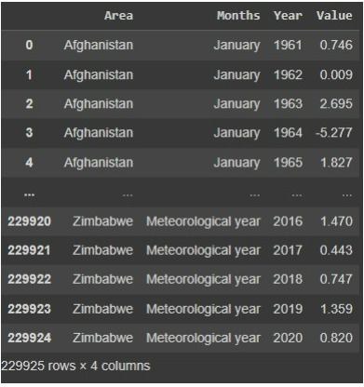

Slide 9
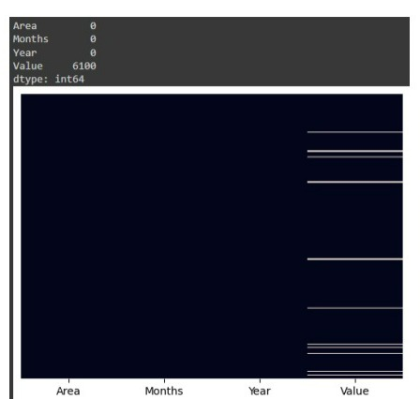
Then, using the heatmap from the seaborn library and the isnull() function from the numpy library, missing values were discovered in the dataset

Slide 10
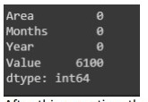
To handle these missing values, pandas provide us with several techniques such as b-fill, f-fill or just dropping the entire row

Slide 11
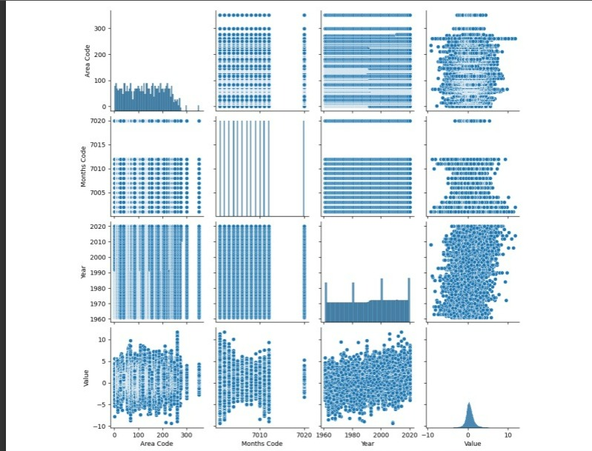
Exploratory data analysis
Using the pairplot() function of the seaborn library, the following inferences were drawn:
.

Slide 12
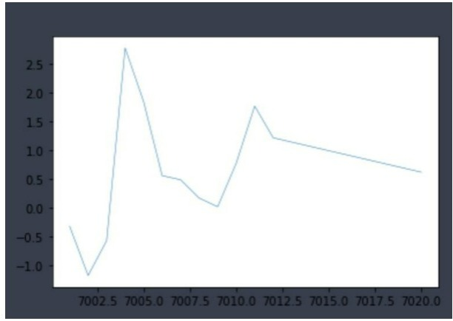
Graph showing the variance of the changes in the mean surface temperature with the changing months in a year:
Some areas experienced higher changes in the mean surface temperature over the years than others.
Some months showed a higher rise in the mean surface temperature than the rest.
Thus, it was concluded that the changes in the surface temperature varied and depended on the time of the year and the area

Slide 13
Model selection
It determines the algorithm or combination of algorithms that will be used to build the predictive model.
Common model selection techniques that are often employed in data analysis and predictive modelling tasks.
1. Linear Regression
2. Sine Regression
3. Decision Trees
4. Random Forests
5. Support Vector Machines (SVM)
6. K-Nearest Neighbors (KNN)
7. XGBoost
8. Deep Neural Networks
The choice of models depends on several factors, including the problem requirements, the available data, computational resources.

Slide 14
MODEL TRAINING AND EVALUATION:
During the model training and evaluation phase, the selected models were trained using the prepared dataset. The dataset was likely divided into two subsets: a training set and a testing set. The training set was used to train the models, while the testing set was held back to evaluate the models' performance on unseen data.
To train the models, the input features from the dataset were used to predict the target variable.
The models were trained to learn the underlying patterns and relationships between the input features and the target variable.
After the models were trained, they were evaluated using performance evaluation metrics.
Commonly used metrics for regression tasks include:
Mean Absolute Error (MAE)
Mean Squared Error (MSE)
R2 Score

Slide 15
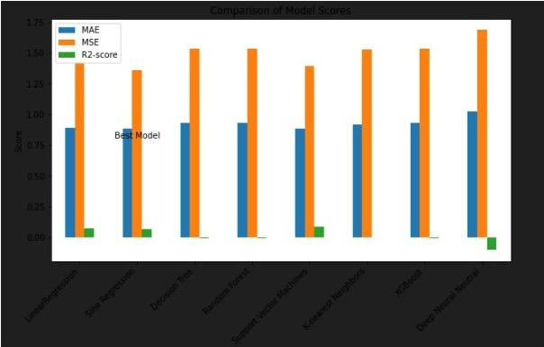
By evaluating the models using appropriate metrics, the project team can assess the models' effectiveness in predicting future changes in mean surface temperature and make informed decisions about which model to select for deployment.
Here is a comparison chart depicting the various metrics for each model that are used for evaluating and choosing the one with the best results:

Slide 16
The sine regression model showed the best results relative to the other models.Hence, the sine-regression model has been selected for the project.

Slide 17
THANK YOU

